Slide 1
MR PHYSICS
Lynne J. Williams, Ph.D.
BCCH MRI Research Facility
May 7, 2019

Slide 2
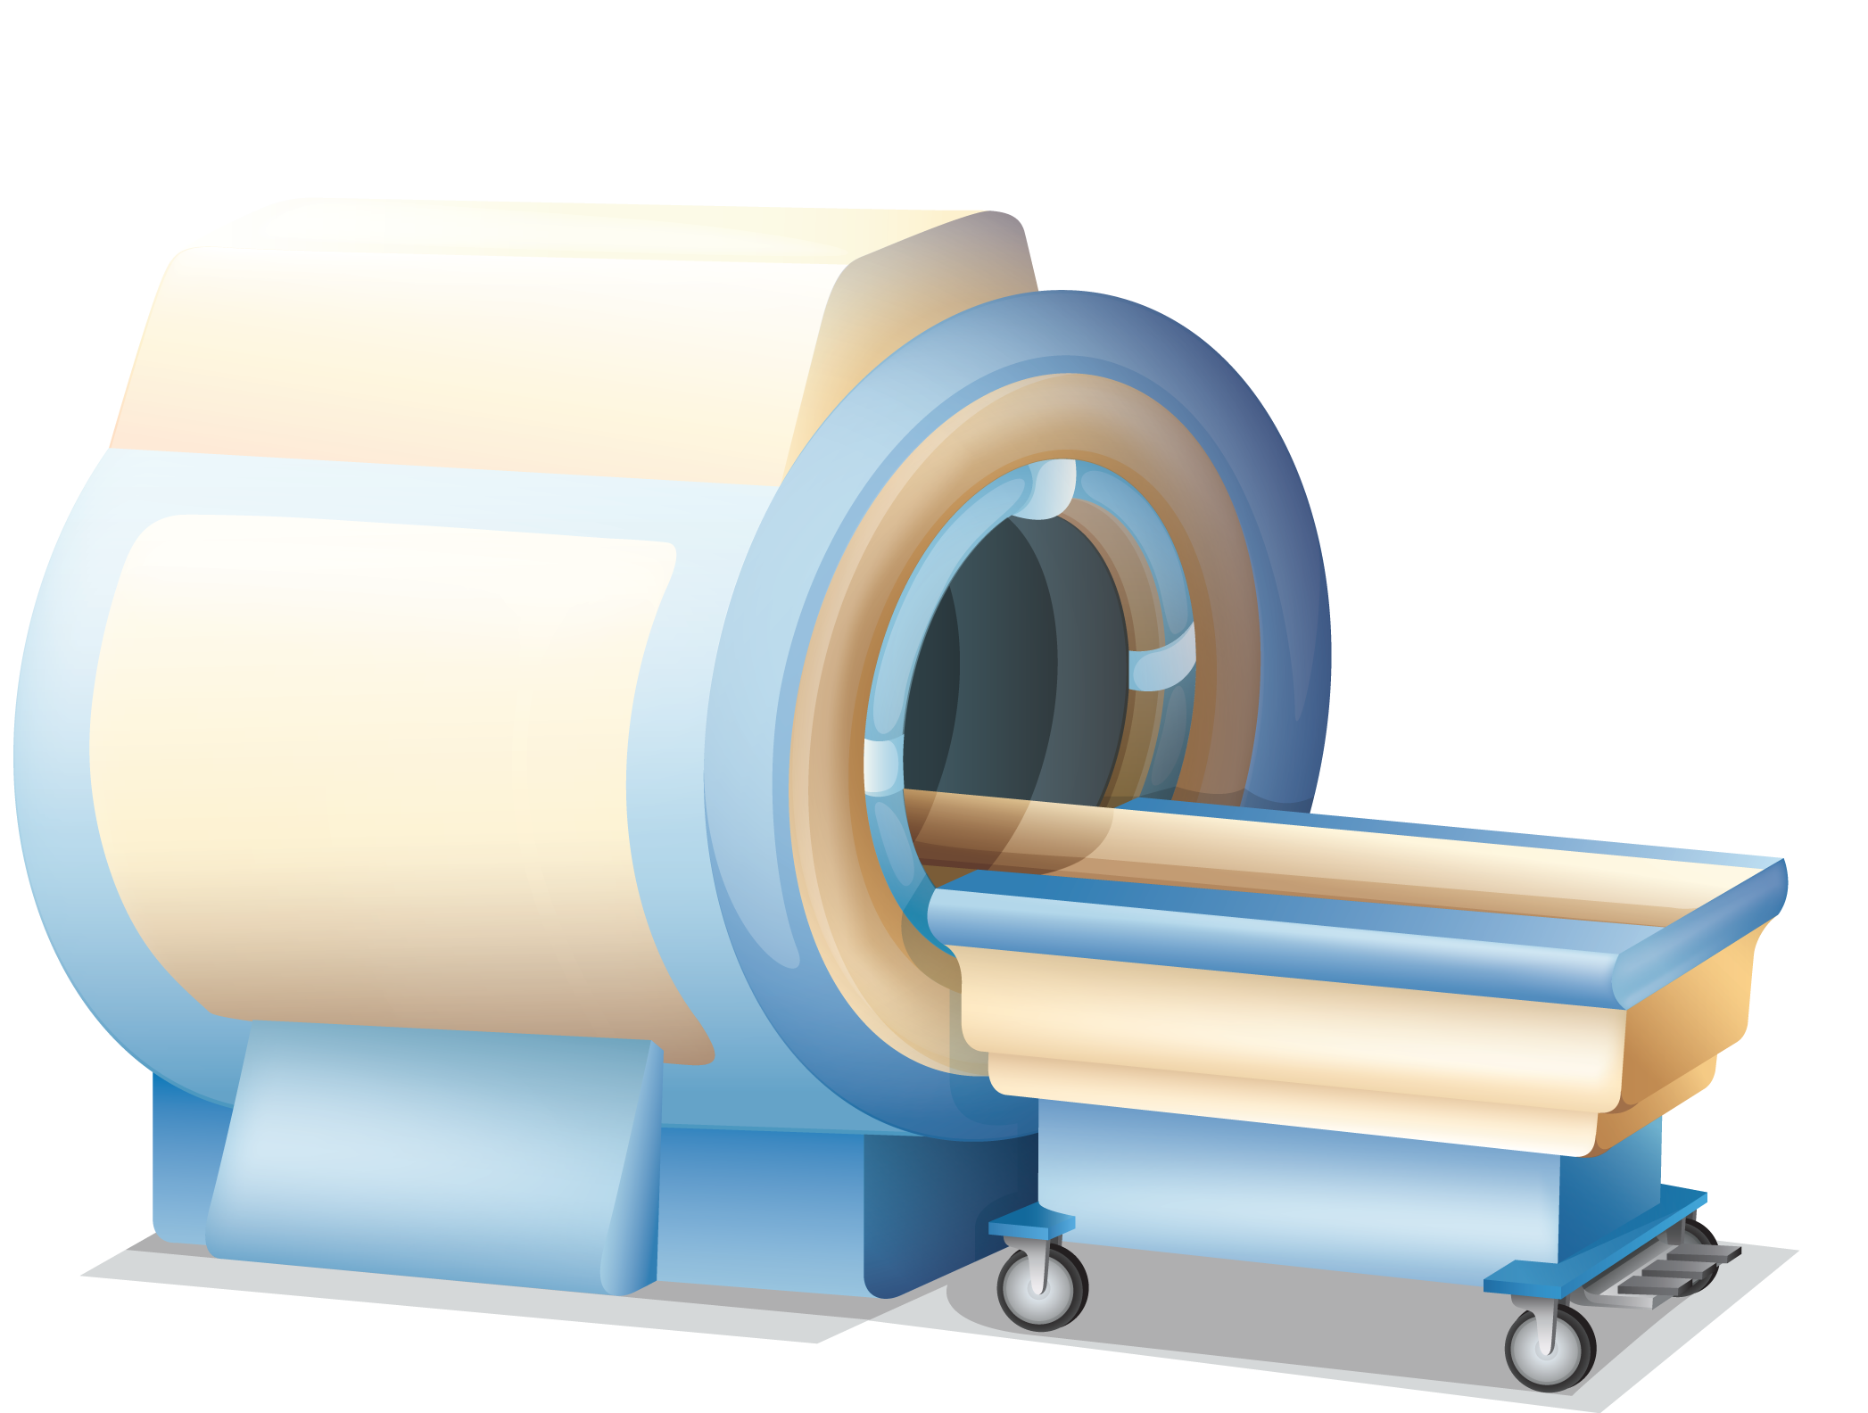
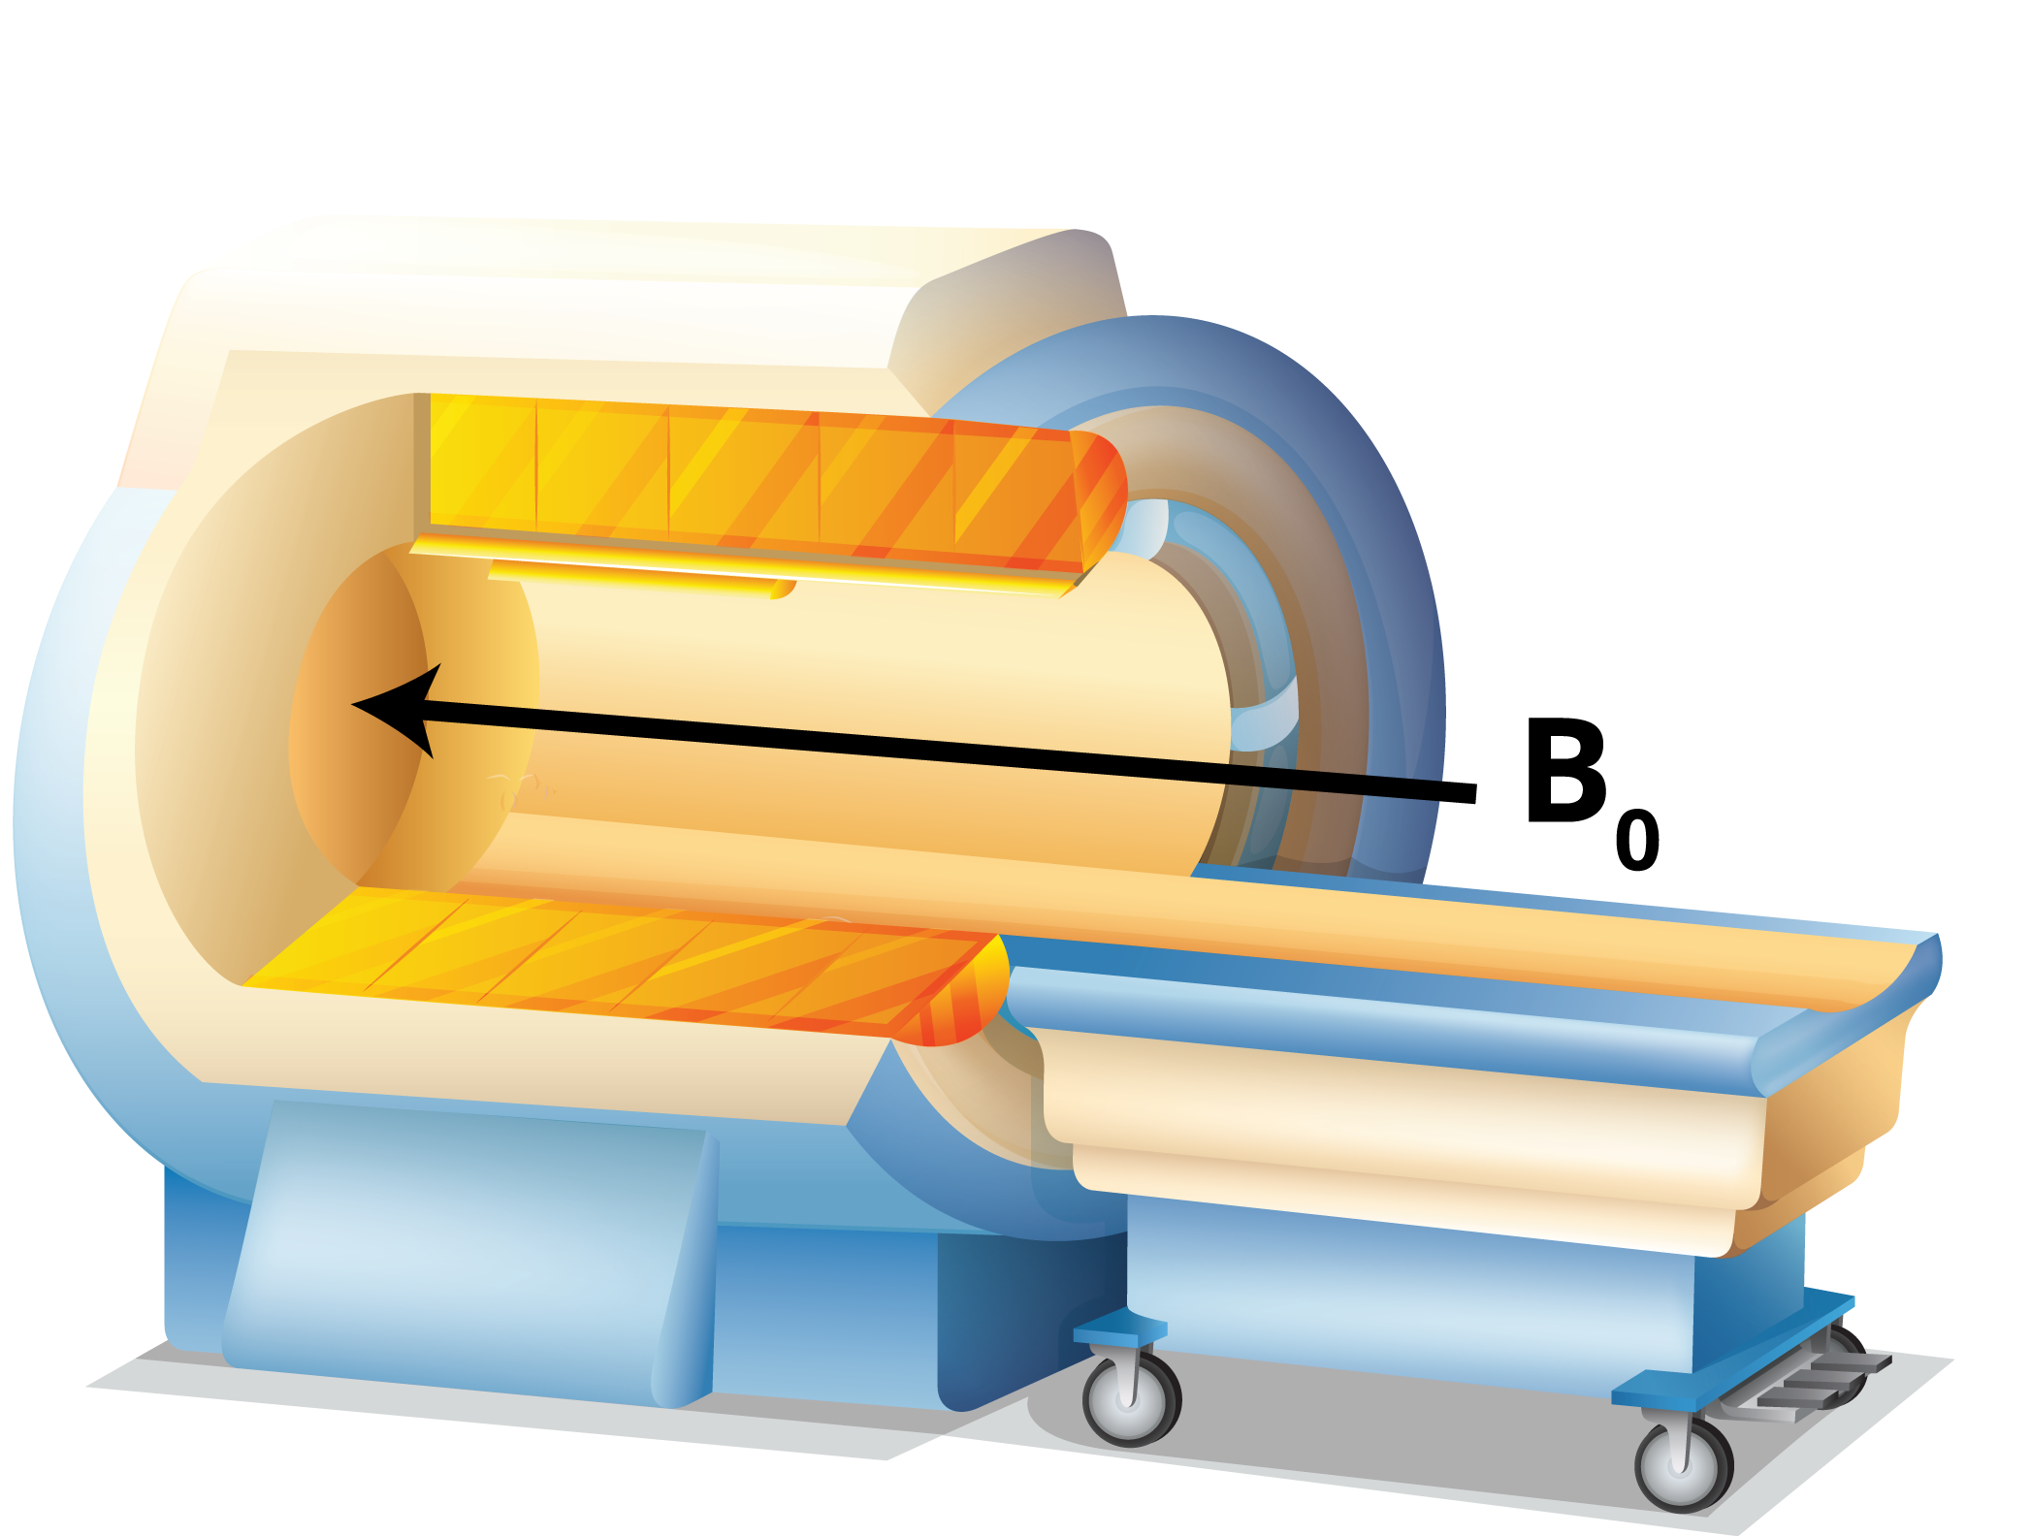


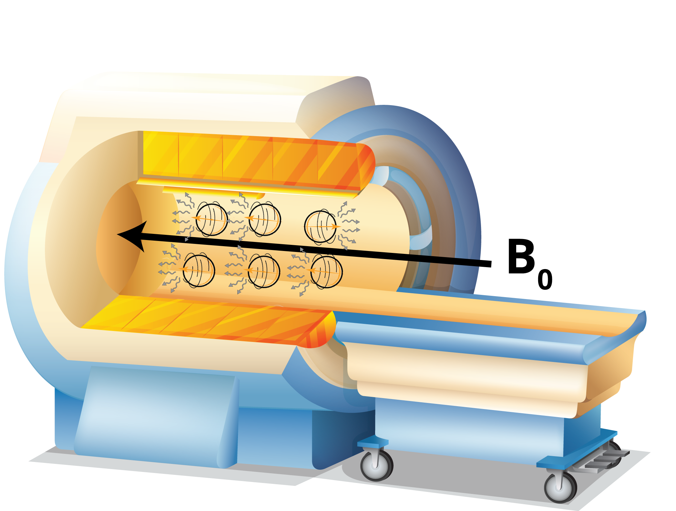
Magnetic Resonance Imaging uses a strong electromagnet to create a magnetic field. Protons within hydrogen atoms align with the magnetic field. Radio waves knock the protons out of alignment, which causes the protons to absorb the energy. As the protons return to alignment, they release the energy which is the MR signal..
WHAT IS
MRI?

Slide 3
WEEK 1
MR PHYSICS
MRI PHYSICS
M is for MAGNETIC (B₀)
Lynne J. Williams, Ph.D.
BCCH MRI Research Facility
May 7, 2019

Slide 4
B₀ IS THE MAGNETIC FIELD
GENERATED BY THE SUPER-CONDUCTING ELECTRMAGNET
The magnet is always on!

Slide 5
MAGNETIC
SUCCEPTIBILITY

Susceptibility is a measure of the extent to which a substance becomes magnetized when it is placed in an external magnetic field

Slide 6
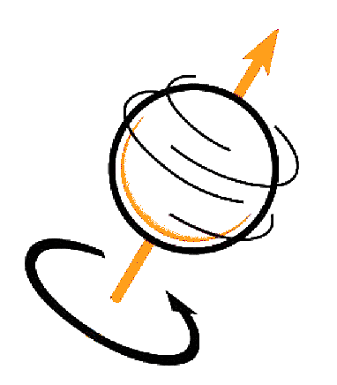
SPIN
ROOT OF SUSCEPTIBILITY

Fermions
Intrinsic Angular Momentum
Bosons
Spin
1/2 integer spin
Whole integer spin
Follow Pauli exclusion
principle
Follow Bose–Einstein statistics
Slide / 01
Can be detected by MRI
Cannot be detected by MRI
Notes:
The Pauli exclusion principle is the quantum mechanical principle which states that two or more identical fermions (particles with half-integer spin) cannot occupy the same quantum state within a quantum system simultaneously.
In quantum statistics, Bose–Einstein statistics (or colloquially B–E statistics) is one of two possible ways in which a collection of non-interacting indistinguishable particles may occupy a set of available discrete energy states, at thermodynamic equilibrium. The Bose–Einstein statistics apply only to those particles not limited to single occupancy of the same state—that is, particles that do not obey the Pauli exclusion principle restrictions.

Slide 7
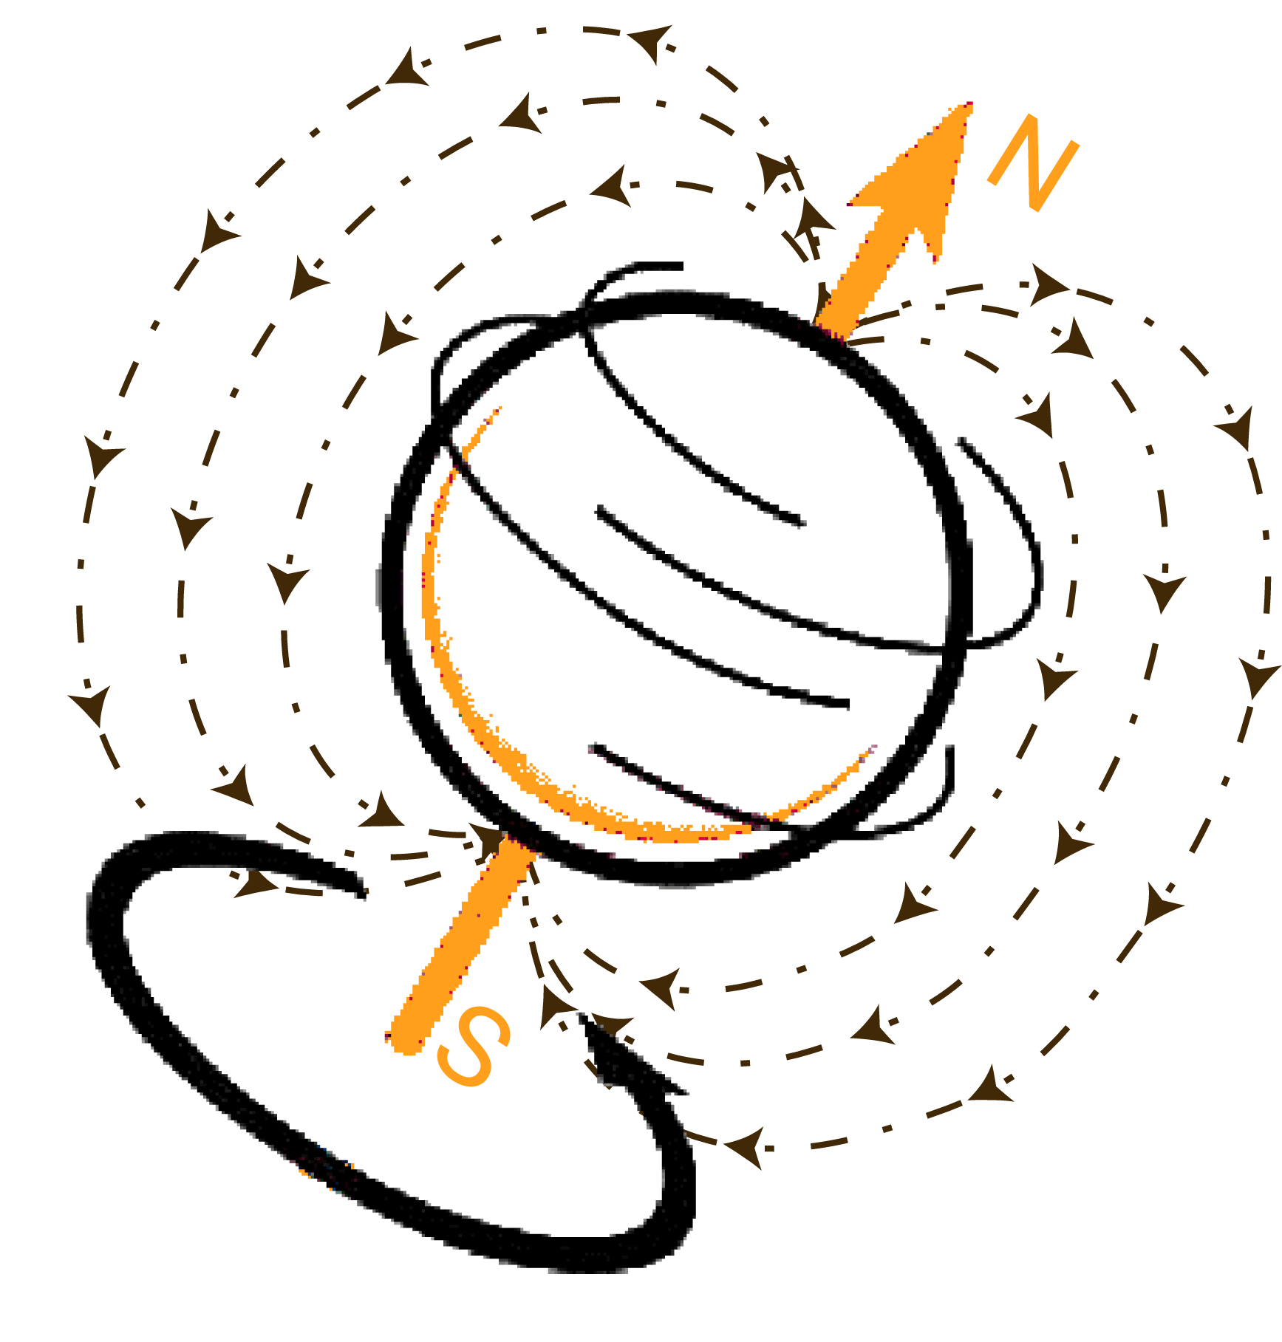
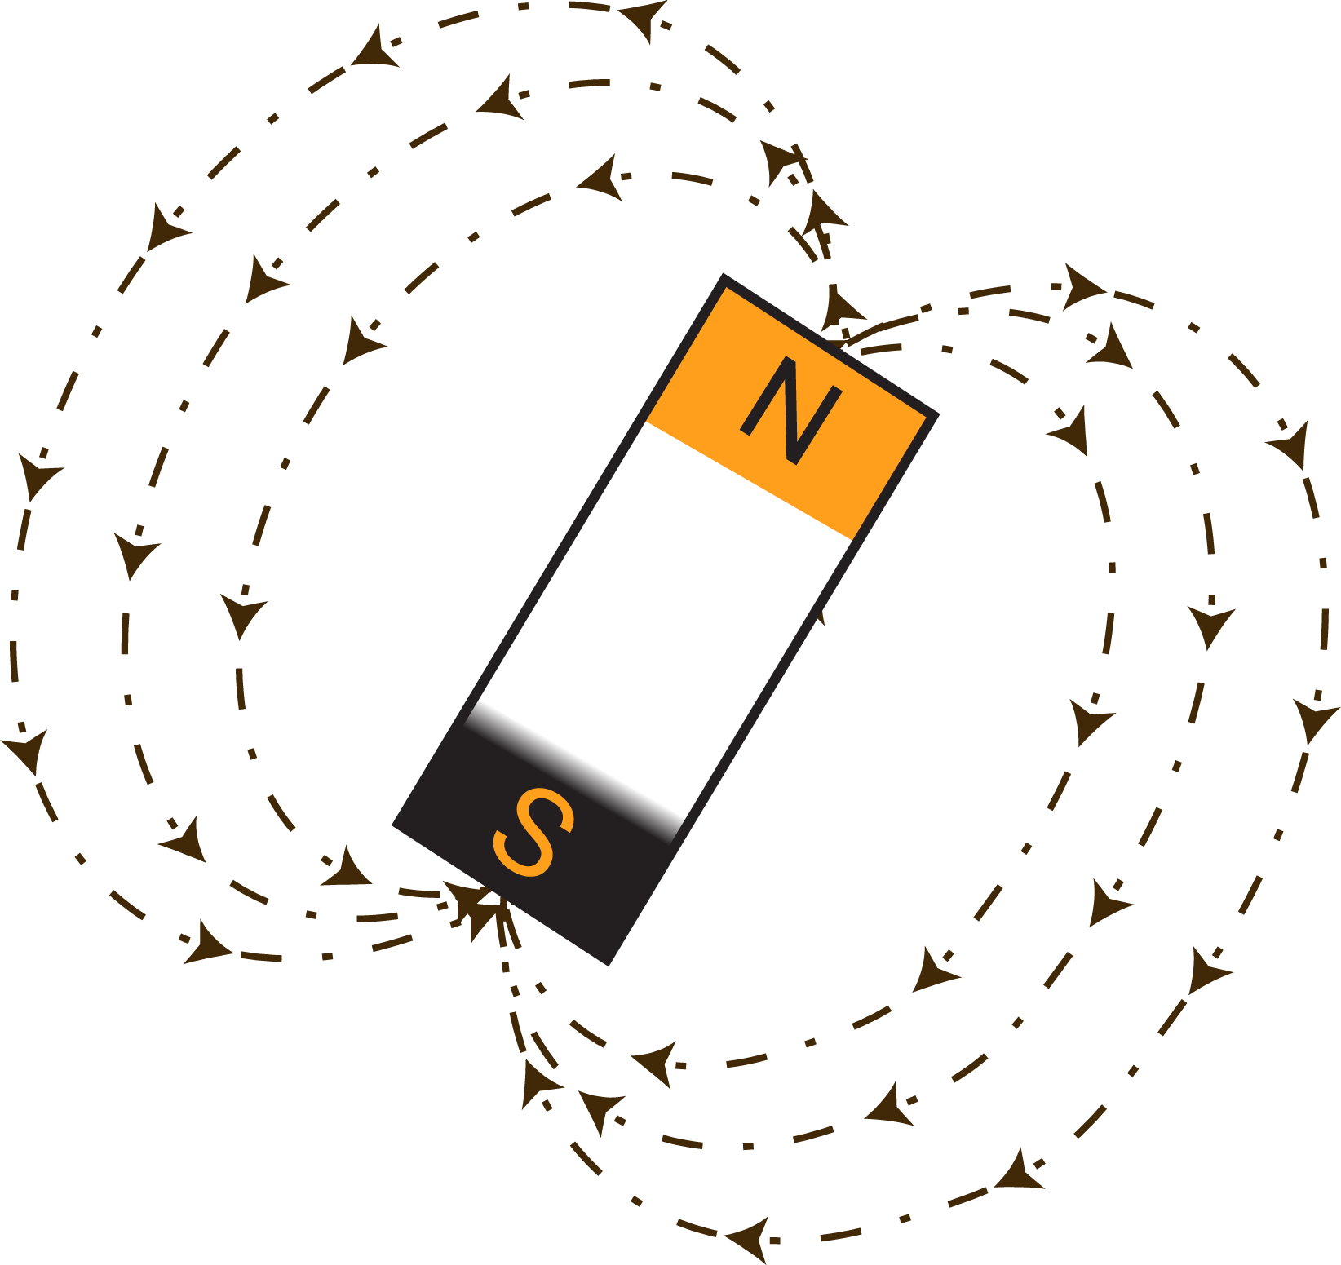
PARTICLES WITH ½ INTEGER SPINS
(INCLUDING HYDROGEN)
ACT AS MINI-MAGNETS
That is, the particles have magnetic moments!

Slide 8
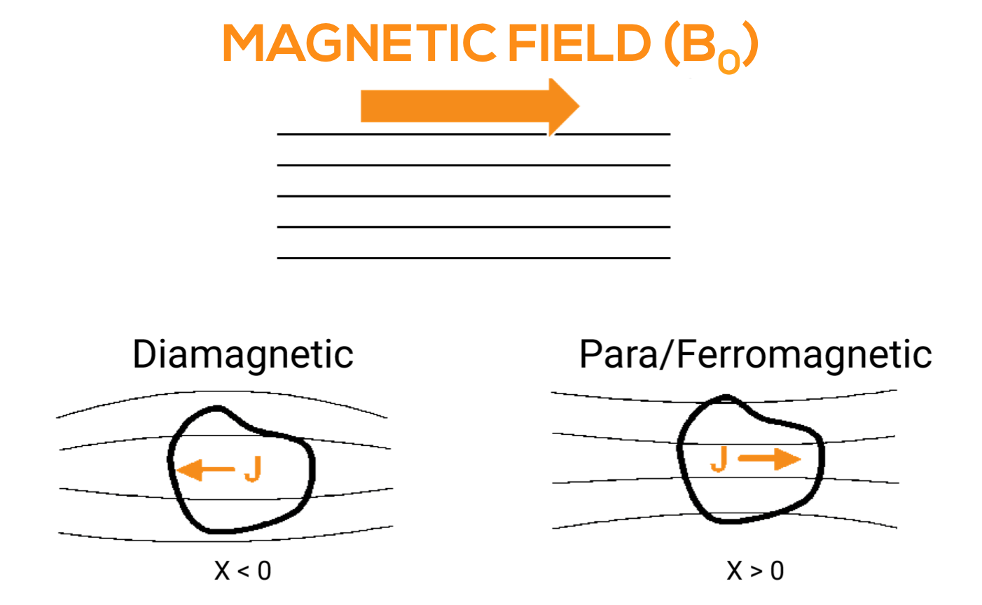
SPIN
TYPES OF MAGNETISM
http://mriquestions.com/
Notes:
Diamagnetic materials are repelled by a magnetic field; an applied magnetic field creates an induced magnetic field in them in the opposite direction, causing a repulsive force. In contrast, paramagnetic and ferromagnetic materials are attracted by a magnetic field.
This augmentation of the external field is called paramagnetism. Subatomic particles may also create magnetic effects that oppose the applied field; this is called diamagnetism.
Susceptibility is caused by interactions of electrons and nuclei with the externally applied magnetic field. Nuclei and electrons each possess spin, a quantum mechanical property with no exact analogue in classical physics. Don't worry if you don't understand this. Not many people do. For now, it's OK just to think of nuclei and electrons as tiny spinning magnets. When nuclear and electron spins in a material orient in the same direction as the magnetic field, their individual magnetic moments locally augment the field. This augmentation of the external field is called paramagnetism. Subatomic particles may also create magnetic effects that oppose the applied field; this is called diamagnetism. Electrons are much smaller than nuclei, so we can think of their spins being as being "concentrated" into smaller volumes. As a consequence of this spin/size discrepancy, electron-field interactions are thousands of times stronger than nuclear ones. Electrons, not nuclei, primarily determine overall magnetic susceptibility of a material. In addition to having spin, electrons "orbit" the nucleus and possess a second quantum property - orbital angular momentum (L). How electrons are distributed among orbitals is critical in determining magnetic susceptibility. Orbitals containing paired electrons contribute to diamagnetism; orbitals with unpaired electrons contribute to paramagnetism. In most substances there are several competing diamagnetic and paramagnetic effects whose net sum determines bulk susceptibility. The major mechanisms contributing to susceptibility are briefly described below: 1. Langevin (Larmor) diamagnetism. This phenomenon results from the angular momentum (L) of electrons in filled orbitals. Through a quantum process similar to Lenz' Law, the orbital motion of paired electrons generates an internal field that opposes the externally applied one. The effect is relatively weak, but because all molecules contain at least some filled orbitals, Langevin diamagnetism is present in all materials. Langevin diamagnetism dictates the overall susceptibility of a material unless it is overridden by a more powerful mechanism. Water, most biological materials, nonmetallic atoms, stable salts, and covalently bonded molecules have no unpaired electrons, so their overall susceptibilities are dominated by Langevin diamagnetism. Their susceptibilities (χ) are weak and negative, typically with values close to −0.00001. 2. Van Vleck paramagnetism. This can be considered a minor counter-effect to Langevin diamagnetism, becoming important only for a few polyatomic molecules and certain atoms/ions with shells exactly one electron short of being half-filled. In water, for example, Van Vleck paramagnetism is only 10% the strength of Langevin diamagnetism. 3. Nuclear paramagnetism. Certain nuclei with non-zero spins (¹H, ¹³C, ²³Na, etc) - the same nuclei that undergo NMR - make a minimal positive contribution to the susceptibility of materials that contain them. As stated above, this effect is extremely small (typically < 0.01% of the already weak Langevin diamagnetism) so it can be largely disregarded except in the immediate vicinity of the nucleus. 4. Curie Paramagnetism. This important mechanism occurs in atoms and molecules with one or more unpaired electrons. It is moderately powerful -- a thousand times greater than Langevin diamagnetism. In such materials the unpaired electrons experience net "alignment" with the external field (similar to the net alignment of nuclei in NMR). This alignment augments the applied field and is therefore paramagnetic. Curie paramagnetism is important in:Atoms, molecules, and lattice defects with odd numbers of electrons (ions, NO, organic free radicals, charged molecules);
Free atoms and ions with partly filled inner shells (transition metals, rare earth elements, actinides and lanthanides -- especially gadolinium);
A few compounds with an even number of electrons but with unpaired spins in bonding or antibonding orbitals (O2).
Among the elements, gadolinium has one of the strongest Curie paramagnetic effects because it possesses 7 unpaired electrons in its 4f shells. For ions like gadolinium with partially filled shells whose magnetism comes purely from electron spin, the degree of expected paramagnetism is proportional to N(N + 2), where N = the number of unpaired electrons. 5. Mechanisms in simple metals (Pauli Paramagnetism and Landau Diamagnetism). Metals can be viewed as closed-shell cores surrounded by a "sea" of free conduction (valence) electrons. The cores have no unpaired electrons and thus exhibit only mild Langevin diamagnetism. The conduction electrons, however, interact more strongly with the external magnetic field. The usual dominant effect is to augment the applied field (Pauli paramagnetism), but they also generate an opposing field (Landau diamagnetism), which is usually smaller than the Pauli effect, but not always. Thus some metals with filled inner shells may demonstrate mild paramagnetism (Al, Ti), while others are weakly diamagnetic (Cu, Pb, Ag). 6. Exchange Coupling and Magnetic Domains. A few elemental and compound solids (containing transition metal and/or rare-earth atoms) demonstrate enormous positive susceptibilities that may even remain after the external magnetic field is removed. The resultant state is called ferromagnetism, whose origin is based on a quantum mechanical effect known as exchange coupling. These materials form magnetic domains - small regions whose spins become locked into orderly arrays and become spontaneously magnetized. Such phenomena are responsible for permanent magnetism of iron, nickel, cobalt and their alloys, and may manifest in different forms including ferromagnetism, ferrimagnetism, anti-ferromagnetism, and superparamagnetism, Ferromagnetism and its subtypes will be discussed more completely in several additional questions.

Slide 9
SPIN
TYPES OF MAGNETISM
Material | Volume Magnetic Susceptibility (Χ) in ppm
Water & most tissues | -9.0
Fat | -8.3
Gadolinium in blood | +0.03
http://mriquestions.com/

Slide 10
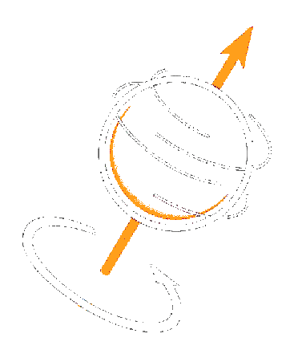
WHAT HAPPENS
WHEN YOU PUT
FERMIONS IN A
MAGNETIC FIELD?
Particles align with B₀ in either spin up or spin down orientations

Slide 11
EVERYONE IS
LINED UP
NOW WHAT?

Slide 12
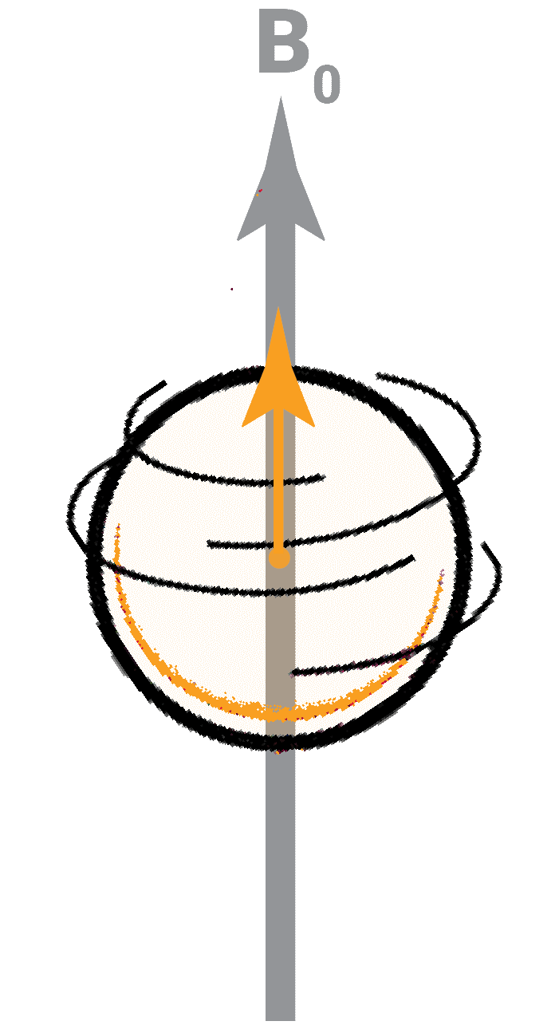
THE WORLD
STARTS TO WOBBLE
Magnetic fields create torque acting perpendicular to the field and the direction of spin. Motion is then deflected into a circular path perpendicular to the field. This circular path is called precession.
Slide / 01

Slide 13
WEEK 1
MR PHYSICS
MRI PHYSICS
R is for RESONANCE (B₁)
Lynne J. Williams, Ph.D.
BCCH MRI Research Facility
May 7, 2019

Slide 14

B₁ IS A MAGNETIC FIELD
GENERATED BY RADIO FREQUENCY WAVES
B₁
B₁ is the
Resonance (Larmor) Frequency
Arrows from https://smart.servier.com/
Notes:
https://smart.servier.com/

Slide 15
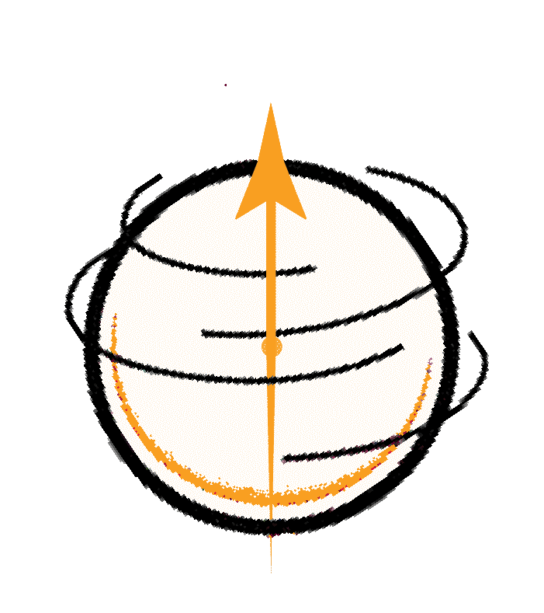
RESONANCE
FREQUENCIES


Precession causes oscillations in the local magnetic field at a known frequency, called the
resonance frequency.

Slide 16
RESONANCE
FREQUENCIES
The frequency of precession is proportional to B₀.
ω = γB
where, ω is the resonance (or Larmor) frequency, γ is a nucleus specific gyromagnetic ratio, and B is the strength of the external magnetic field.

Slide 17
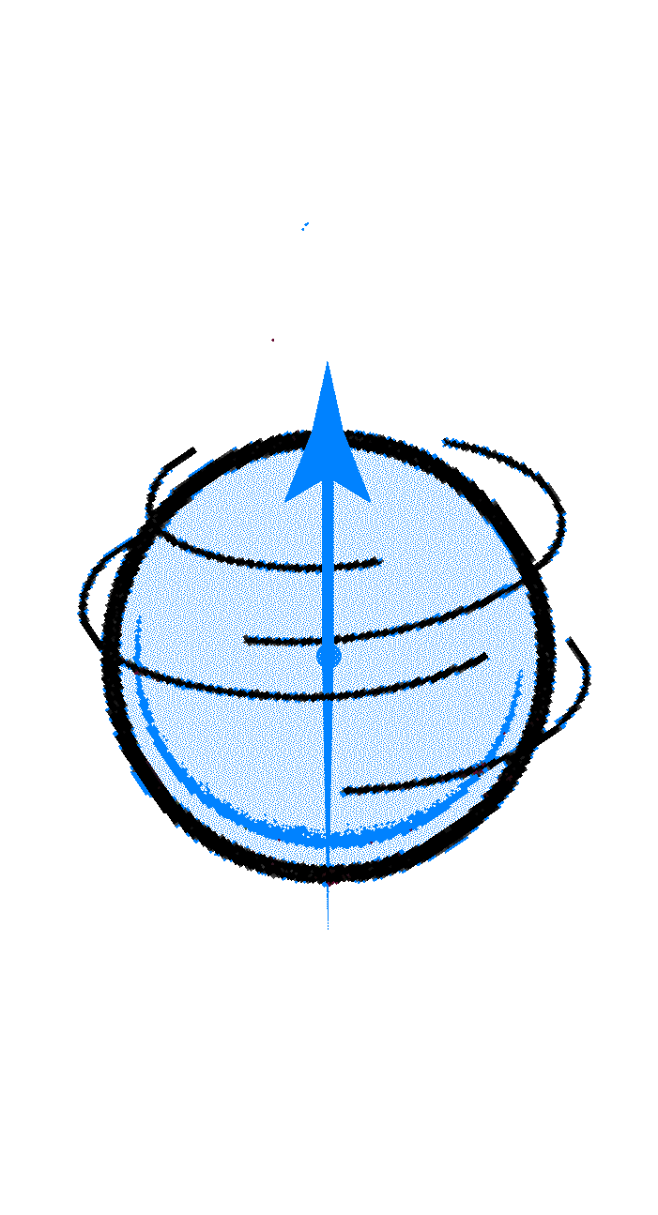
RESONANCE
FREQUENCIES
Each particle precesses at its own resonance frequency.
 | Resonance Frequency at 1T
¹H | 42.58 MHz
³⁹K | 1.99 MHz
²³Na | 11.262 MHz
 | Resonance Frequency at 1T
¹H | 42.58 MHz
³⁹K | 1.99 MHz
²³Na | 11.262 MHz

Slide 18
Notes:
Each particle precesses at its own resonance frequency.
If you send radio-frequency waves (B1) at the same frequency, then you can ‘knock’ a given particle over. It will release the energy when it returns to alignment with B0.

Slide 19

A RADIO WAVE AT THE LARMOR FREQUENCY `KNOCKS’ OVER THE PARTICLES
B₁
Notes:
Each particle precesses at its own resonance frequency.
If you send radio-frequency waves (B1) at the same frequency, then you can ‘knock’ a given particle over. It will release the energy when it returns to alignment with B0.

Slide 20
A RADIO WAVE AT THE LARMOR FREQUENCY `KNOCKS’ OVER THE PARTICLES
B₁
THE PARTICLES RELEASE ENERGY AT THE SAME FREQUENCY WHEN THEY COME BACK INTO ALIGNMENT WITH B₀
Notes:
Each particle precesses at its own resonance frequency.
If you send radio-frequency waves (B1) at the same frequency, then you can ‘knock’ a given particle over. It will release the energy when it returns to alignment with B0.

Slide 21
WEEK 1
MR PHYSICS
MRI PHYSICS
I is for IMAGING
Lynne J. Williams, Ph.D.
BCCH MRI Research Facility
May 7, 2019

Slide 22
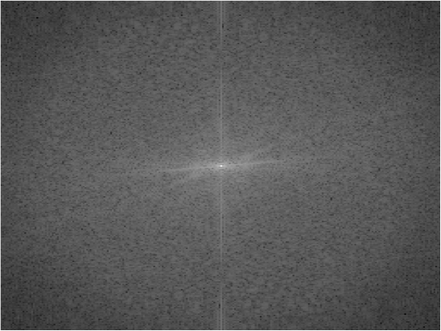
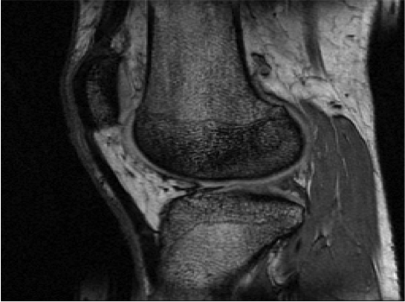



WHAT IS
K SPACE?
K-space is where we store our MR signals
K-space is an array of numbers
K-space is related to the image we see via the Fourier Transform
Modified from DHiggins ReviseMRI

Slide 23
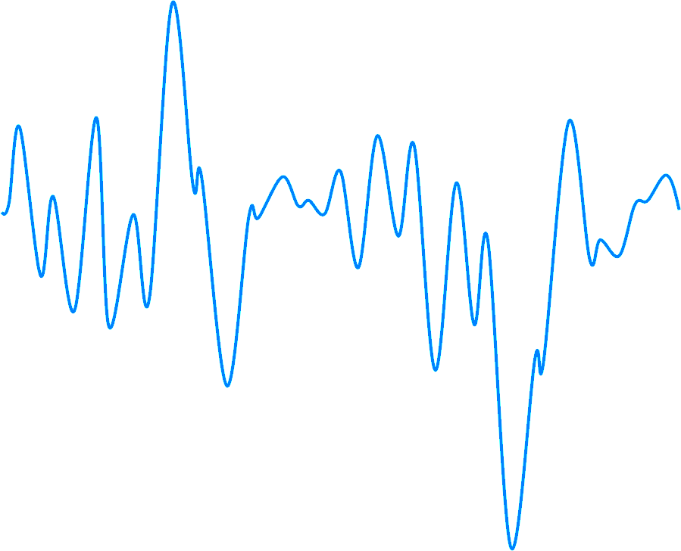

STORING
DATA IN
K-SPACE
The MR signal is digitized and the amplitude is recorded
Many samples under many different conditions are required to generate k-space that can be converted into a recognizable image
Modified from DHiggins ReviseMRI

Slide 24
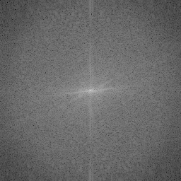
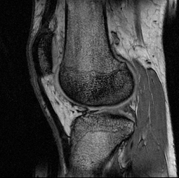
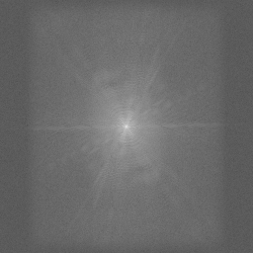
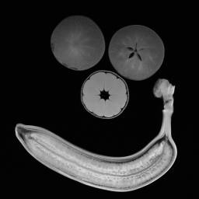
K-SPACE
TO IMAGE
K-spaces representing different objects vary quite a lot. You can’t necessarily tell what the image represents, but there are some hints as to data quality …
Modified from DHiggins ReviseMRI

Slide 25
k = 2 m⁻¹
THE K
OF K-SPACE
1m
K
is a wave number that refers to the number of cycles in one meter of linear space.
K-space
is the plot of all possible wave numbers.
Modified from DHiggins ReviseMRI
Notes:
Stationary plane waves may be characterised by an amplitude and a wave number. The term wave number refers to the number of complete wave cycles that exist in one metre of linear space (units: cycles m⁻¹). The wave number is traditionally denoted by the letter k.

Slide 26
k = 3.25 m⁻¹
THE K
OF K-SPACE
1m
Frequency & Phase
K-space is complex!
Plane waves with identical wave numbers (same frequency) may still differ with regard to their phase.
It represents both the amplitude and phase information
Nearly out of
phase
Nearly in phase
Modified from DHiggins ReviseMRI

Slide 27
FROM K-SPACE
TO IMAGE
Every point in k-space represents
the phase and frequency
of a wave.
The brightness of the wave in the image
depends on the brightness of
the value of the number at that point
in k-space!
Modified from DHiggins ReviseMRI

Slide 28
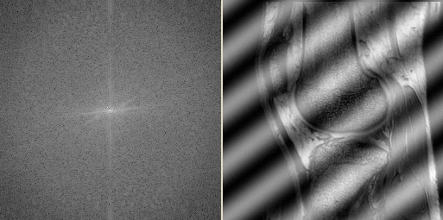
THE CENTRE
OF K-SPACE
Increasing the amplitude/brightness at a single point in k-space can cause major changes to the image.
If you increase the brightness here, you get large undulating stripes in the final image
[An RF-noise spike might cause such an artefact in real life.]
Modified from DHiggins ReviseMRI

Slide 29
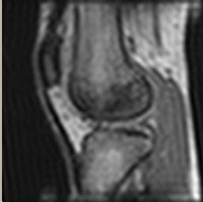
THIS GIVES CONTRAST
Here we have used only the low spatial frequencies to create the image. Remember, these data points in k-space produced only large waves on the image.
The resultant image contains mainly contrast and little detail / edge information. This makes sense, because we need to add high frequency waves to be able to draw fine-detail.
Modified from DHiggins ReviseMRI

Slide 30
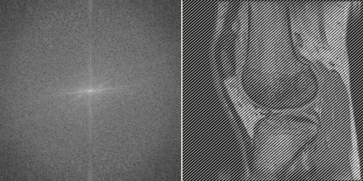
THE EDGES
OF K-SPACE
Increasing the amplitude/brightness at a single point in k-space can cause major changes to the image.
If you move farther out, the spatial frequency increases so that you get narrower stripes in the image
Modified from DHiggins ReviseMRI

Slide 31
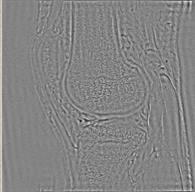
THIS GIVES DETAILS & EDGES
Here we are using only higher spatial frequencies (towards the edges) and the lower spatial frequencies have been omitted.
Large areas of bright and dark (i.e. contrast information) cannot now be drawn on the image because this cannot be done without large bright/dark waves: low spatial frequencies. The image has only the edges and detail information..
Modified from DHiggins ReviseMRI

Slide 32
THE MAGIC OF THE FOURIER TRANSFORM
HOW DOES K-SPACE WORK?

Slide 33
The Fourier Transform allows us to determine the constituent waves of any signal
FT
Modified from DHiggins ReviseMRI
Notes:
The signals that we measure in MRI are a combination of signals from all over the object being imaged.
It so happens that any signal (even if you simply make one up and draw a squiggle) is composed of a series of sine waves, each with an individual frequency and amplitude. The Fourier transform takes the signal (or squiggle!) and works out what those constituent frequencies and amplitudes are.
(That is to say, it converts the signal from the time domain into the frequency domain.)
Since we spatially encode the signal with magnetic field gradients which make frequency and (rate of change of) phase relate to position, if we can separate out the frequencies we can say where what frequencies and amplitudes should be plotted to create the image. You’ll see this in action in a couple of slides time.

Slide 34
SPATIAL
ENCODING
FIRST WE START WITH THE COMPOSITE WAVE
Note the only difference between the voxels is the AMPLITUDE of the signal
Modified from DHiggins ReviseMRI

Slide 35
SPATIAL
ENCODING
FREQUENCY ENCODING
The SPATIAL FREQUENCIES get separated out via a FOURIER TRANSFORM.
This gives you the columns of k-space.
Modified from DHiggins ReviseMRI

Slide 36
SPATIAL
ENCODING
PHASE ENCODING
Now you do another FOURIER TRANSFORM.
This gives you the rows of k-space.
2 rows means 2 different phase encodings
Row 1: 0 degrees
Row 2: 180 degrees
More rows means more gradations in phase encoding
radiofrequency signals
Modified from DHiggins ReviseMRI

Slide 37
A
C
E
phase encoding
B
D
F
SPATIAL
ENCODING
frequency encoding
C+D
A+B
E+F
No phase encoding
FT
freq.
A+B+C+D+E+F
FT
C-D
180° phase shift
A-B
E-F
A+B+C+D+E+F
freq.
Modified from DHiggins ReviseMRI

Slide 38
0 | 0 | 0
0 | 0 | 0
0 | 0 | 0
-1 | 0 | +1
-1 | 0 | +1
-1 | 0 | +1
0 | +1 | +2
-1 | 0 | +1
-2 | -1 | 0
0 | +1 | +2
-1 | 0 | +1
-2 | -1 | 0
WHY NOT
FREQUENCY
ENCODE IN
BOTH
DIRECTIONS?
− frequency encode +
− frequency encode +
When you have more than 2 rows, it doesn’t work – there are always 2 or more pixels with the same frequency
INSTEAD, WE INTRODUCE DIFFERENT AMOUNT OF PHASE CHANGE OVER MANY STEPS
Modified from DHiggins ReviseMRI

Slide 39
RECALL
WE HAVE
PHASE
CHANGE
Modified from DHiggins ReviseMRI

Slide 40
Change
phase
(one line only)
INTRODUCE
PHASE
CHANGE
This turns into a phase record
Over all levels, we get a rate of change of phase
Rate of change of phase is a FREQUENCY
Slide / 01
Modified from DHiggins ReviseMRI

Slide 41

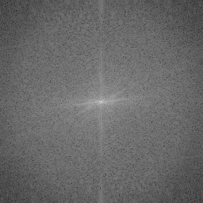
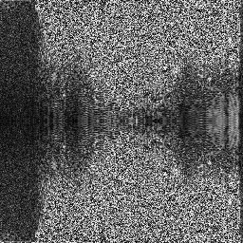
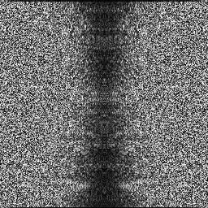
1DFT
1DFT
1DFT
THEREFORE,
IT DOES NOT MATTER
WHICH WAY THE FOURIER TRANSFORMS GET APPLIED!
1DFT
Modified from DHiggins ReviseMRI
Notes:
You might ask: Why use Fourier transforms? I thought the images were made from the superposition of many spatial frequencies as shown in the first k-space tutorial! We could superimpose all the spatial frequencies from k-space, but for a 256*256 image, this would mean 65536 arrays of 256*256 pixel values to cope with! That’s a lot of calculation. The Fourier transform is a short cut to the correct image data.

Slide 42


© 2018 BC CHILDREN’S HOSPITAL MRI RESEARCH FACILITY
This work is licensed under the Creative Commons Attribution-NONCOMMERCIAL-ShareAlike 4.0 International License. To view a copy of this license, visit http://creativecommons.org/licenses/by-nc-sa/4.0/..
THANK YOU
BCCH MRI Research Facility

